Slide 1

1. Break down LGOBE

Slide 2
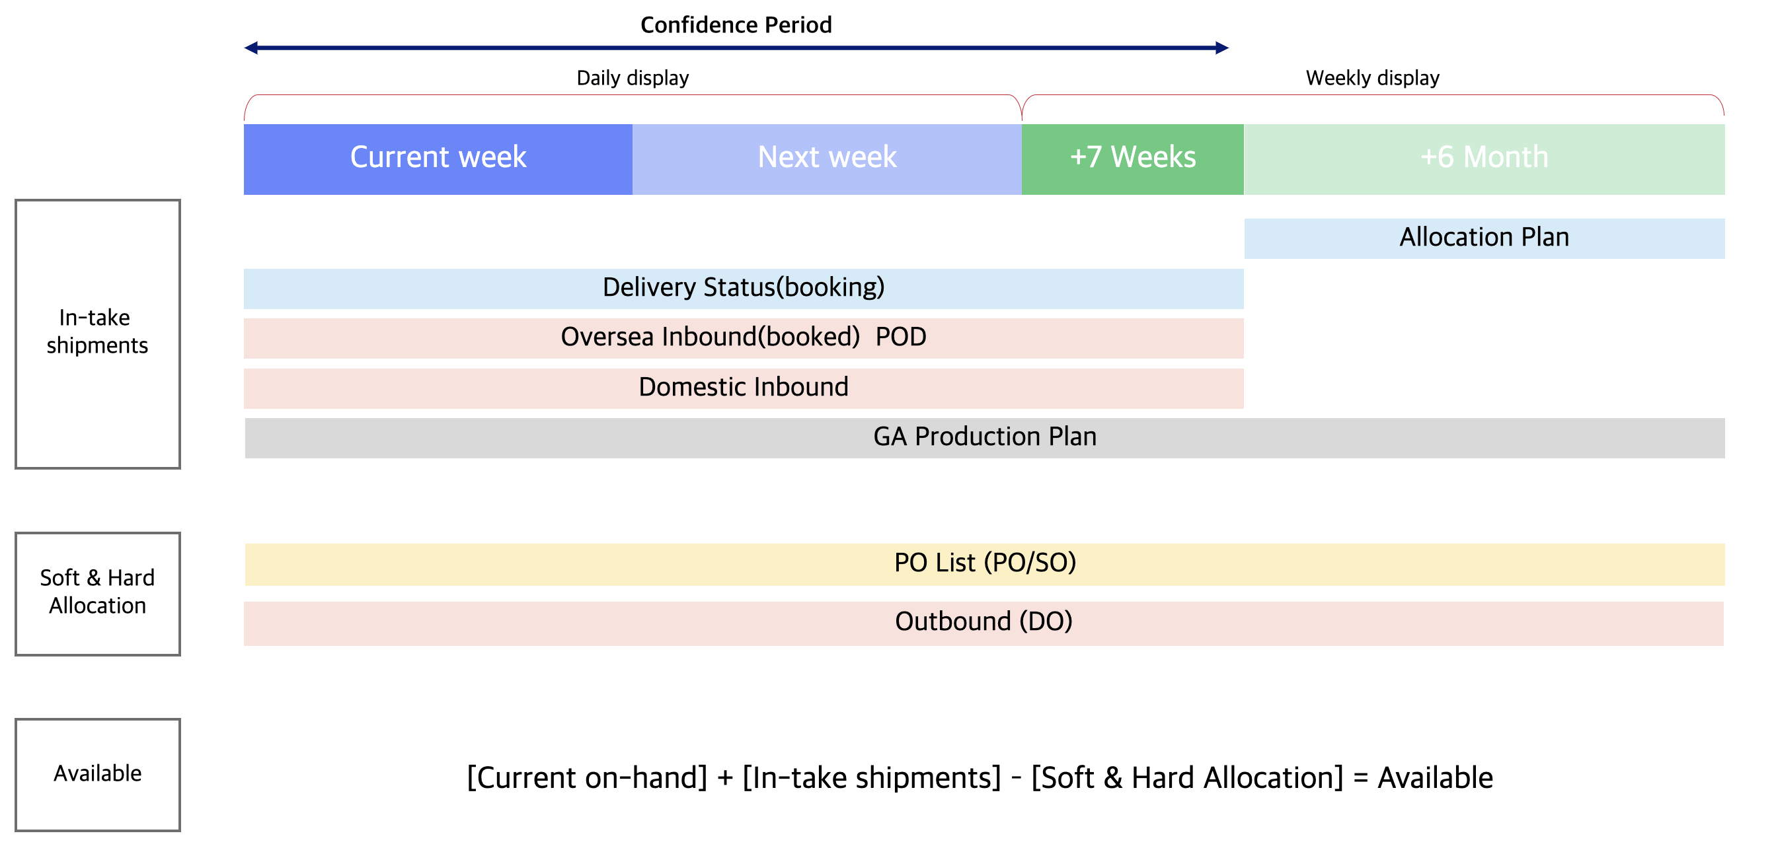
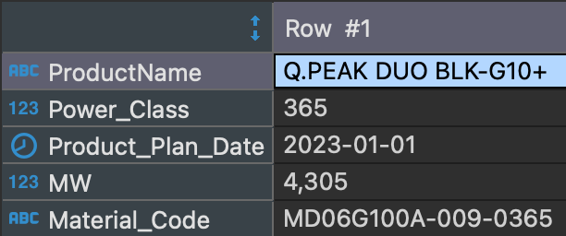
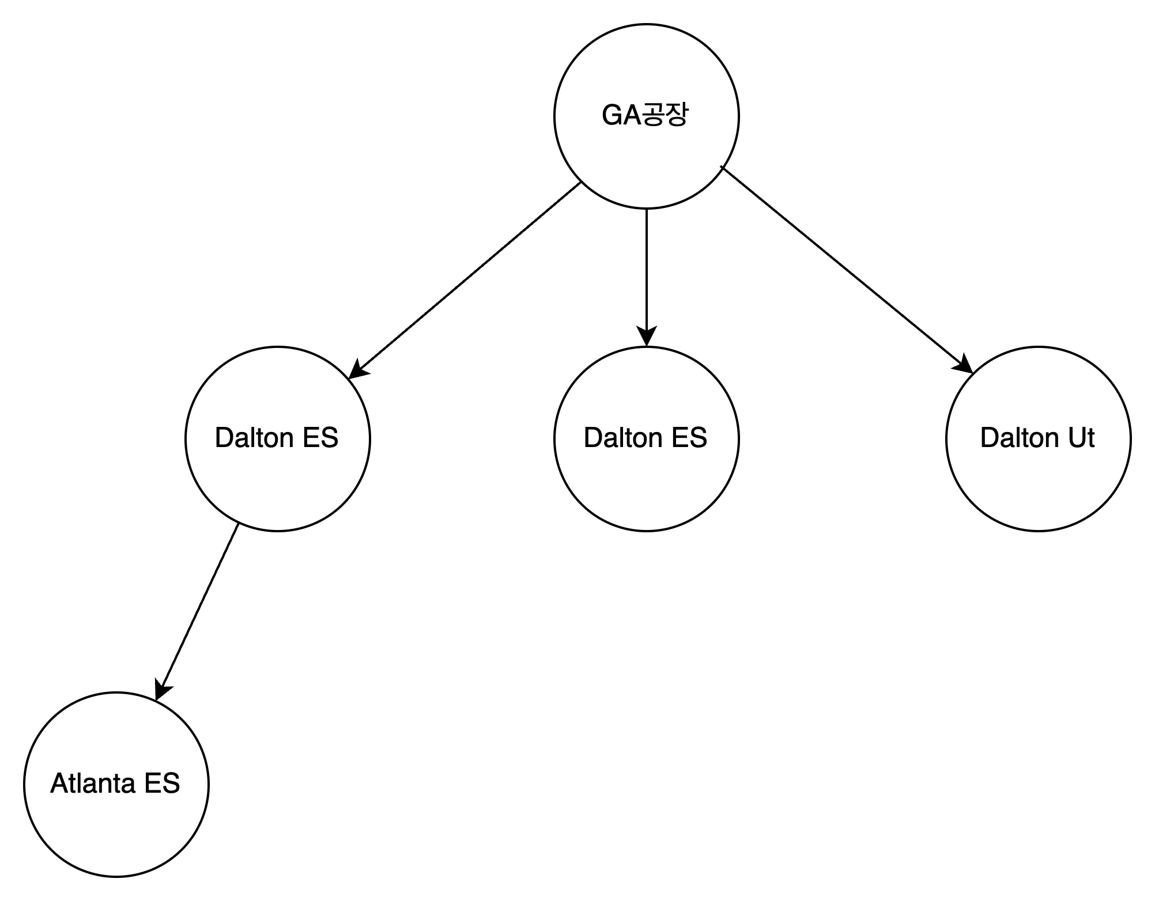
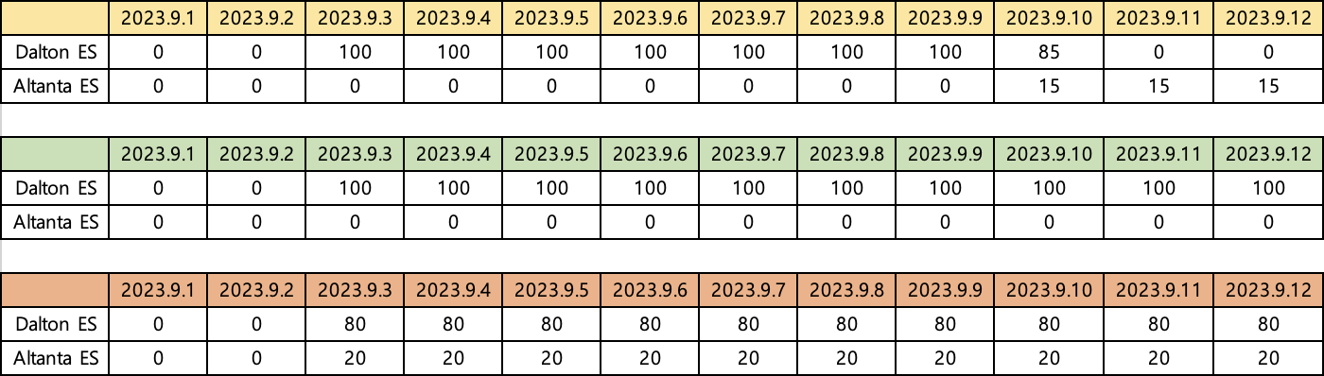
Introduction
AS-IS Data Configuration
After GA production, it is operated in GA
Moved to warehouse only
BUT WHAT LGOBE
Not knowing if it's moving.
Production plan data
Estimated warehouse location data
No, you need to specify the expected warehouse.
Predict the position of the LGOBE in the GA production plan data and then distribute it.
Two-way distribution rules
1. Node quantity based: 창고 적재 수량 비율로 산출
2. Edge quantity based: 창고 이동 수량 비율로 산출
Edge
Node quantity based
Node
Edge quantity based

Slide 3
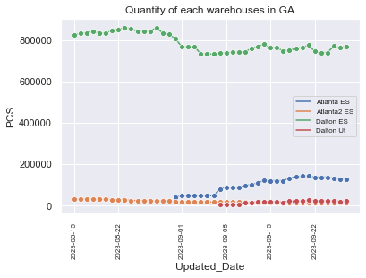
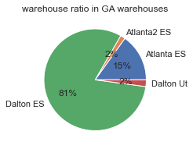
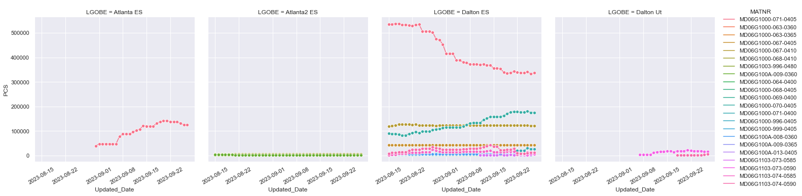
Graph
Factory plan data
SUMMARY
1. Products produced at GA factory are moved to GA's internal warehouse.
2. MD06G1000-068-0405,071-0405 Only two products have a lot of logistics movement.
3. Dalton ES, Atlanta ES 창고를주로이용함.
4. Dalton ES MD06G1000-071-0405 products are in stock
When lowered, the STO was reduced as the inventory of the Atlanta ES went higher.
Appears to be occurring.
5. The reason for STO is MD06G1000-068-0405 Due to the rising inventory, it is expected that the capacity of the Dalton ES warehouse will be limited.
It is unknown why MD06G1000-068-0405 was not sent to Atlanta ES instead of MD06G1000-071-0405.
Logistics movement only for specific LGOBEs
Logistics movement only for specific LGOBEs
Operates 2 LGOBE mainly.
Only specific product codes are transferred
Only specific product codes are transferred
Only specific product codes are transferred

Slide 4
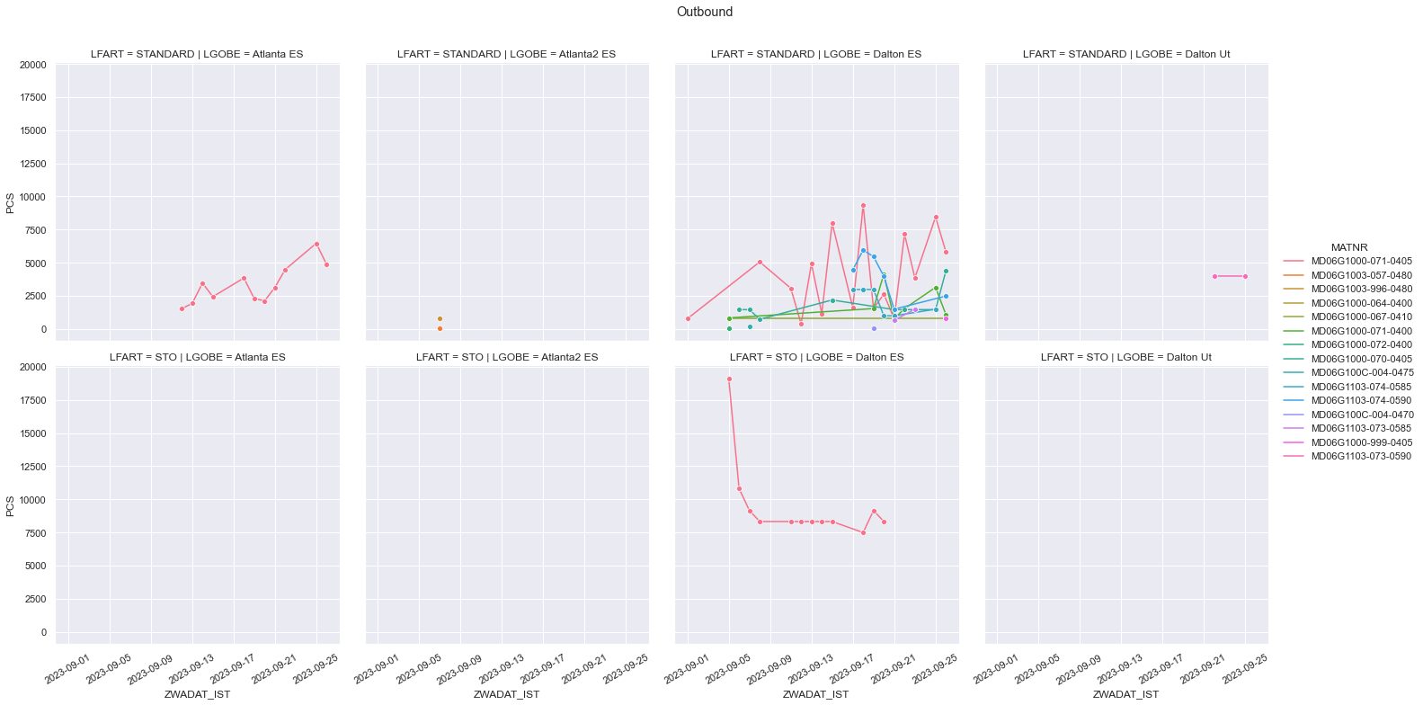
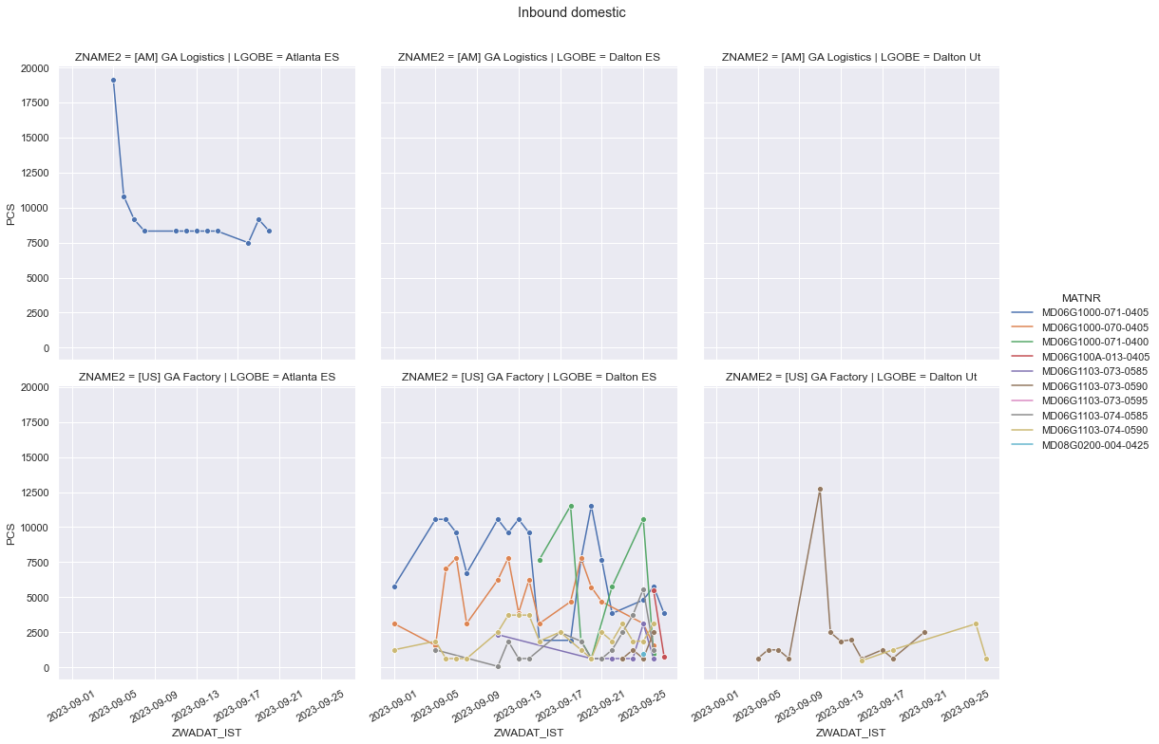
Graph
Inbound & Outbound data
SUMMARY
1. Products produced at GA factory are moved to GA's internal warehouse.
2. MD06G1000-068-0405,071-0405 Only two products have a lot of logistics movement.
3. Dalton ES, Atlanta ES 창고를주로이용함.
4. Dalton ES MD06G1000-071-0405 products are in stock
When lowered, the STO was reduced as the inventory of the Atlanta ES went higher.
Appears to be occurring.
5. The reason for STO is MD06G1000-068-0405 Due to the rising inventory, it is expected that the capacity of the Dalton ES warehouse will be limited.
It is unknown why MD06G1000-068-0405 is not sent to Atlanta ES.
6. MD06G1000-068-0405 Dalton ES may lower STO by increasing the proportion of direct customer sending.
7. MD06G1000-071-0405 only go to Dalton after production.
8. MD06G1000-068-0405 only go to Dalton after production.
The product in question is
Not only available at a specific LGOBE
Applicable Product STO
Departure from Dalton ES
Applicable Product STO
Atlanta S9 도착
The specific products produced are
Warehouse transfer to a specific LGOBE
The specific products produced are
Warehouse transfer to a specific LGOBE

Slide 5
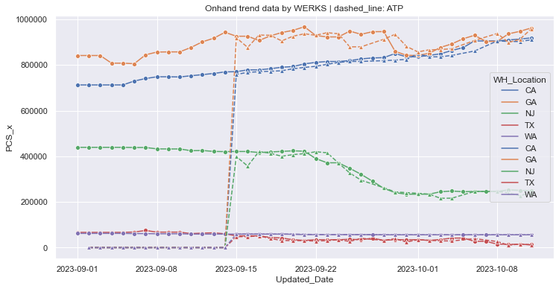
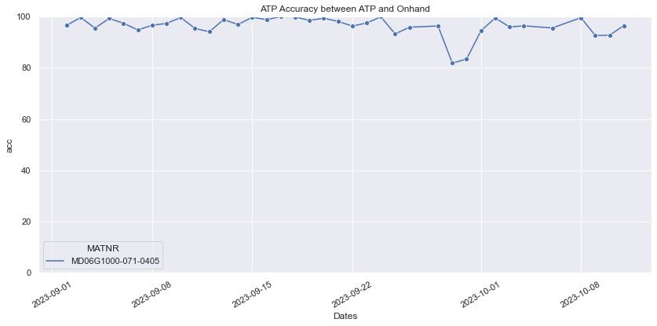
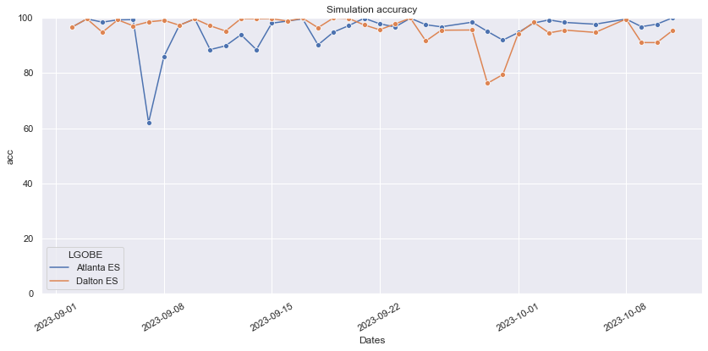
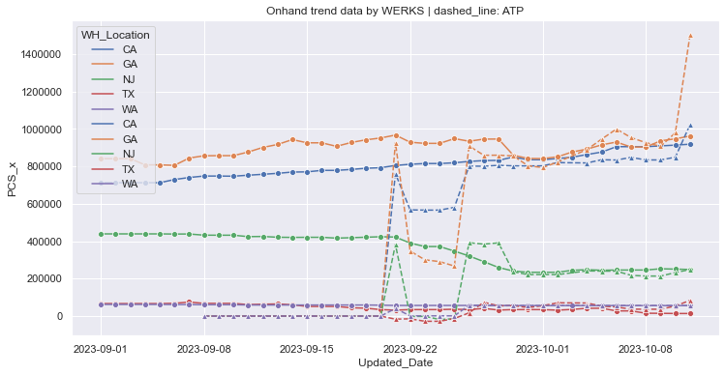
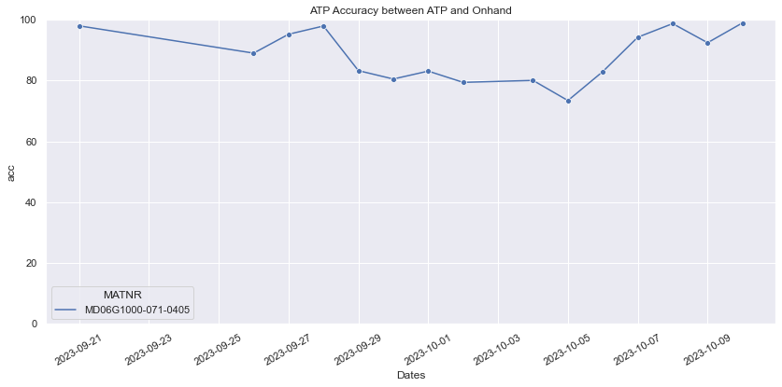
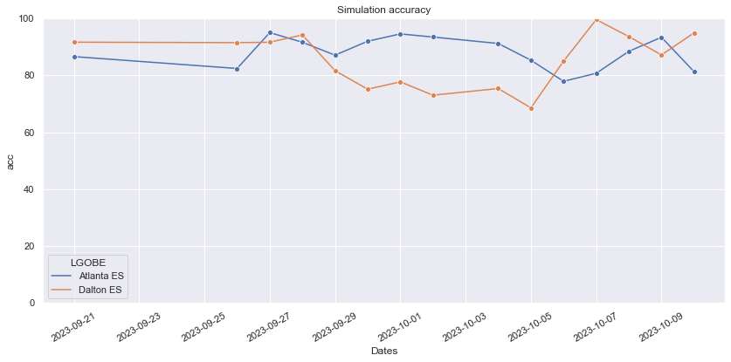
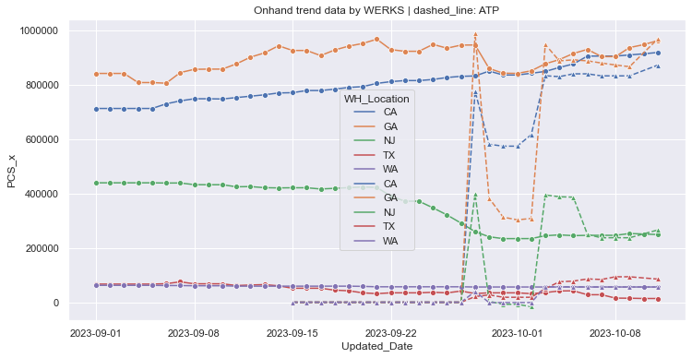
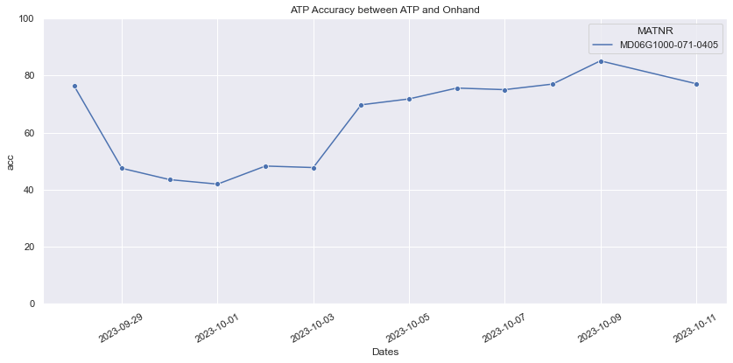
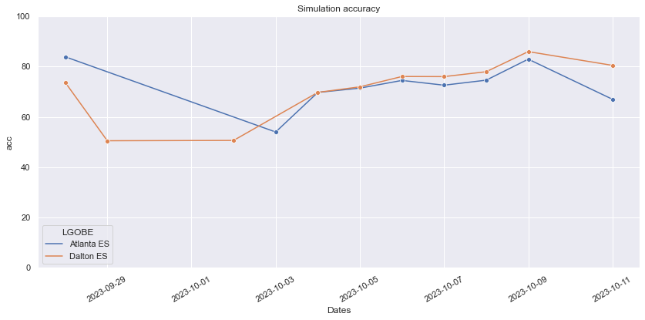
Graph
simulation
Accuracy = (1- abs(y – y_hat)) / y
Outbound ETD Procrastination Logic Issues
Due to PO volatility
Use ATP data that only reflects hard allocation

Slide 6
Graph
Simulation accuracy result
Conclusion
1. Immediately after production, the products will only be moved to a single Dalton warehouse under operation.
2. Graph Edge based방식을 이용하여 STO수량을 반영.
3. If you know the logic of MATNR, PCS, and Dates to proceed with STO, you can reduce the loss of the Graph Edge based method.
4. ATP forecast 날짜가 뒤로 갈수록 Accuracy는 낮아짐.
5. There are four main causes of loss of accuracy.
Factory Plan: Difference in output compared to after production plan
Inbound Domestic: 생산계획 대비 창고 입고량 차이
Outbound: ETD대비 GI Date의 차이(DO delay)
STO: Insufficient information on target products, quantities, and dates of STO
forecast day | 1day | 7days | 14days
total acc | 95% | 90% | 85%
split acc | 95% | 80% | 70%

